Slide 1
FY 2019 Fleet and Strategy Optimization Lariat Rent-A-Car
Matthew Seelig

Slide 2
Purpose: Optimize revenue and profit for future fiscal years
Notes:
Good morning. The data analytics team was presented with the task of optimizing revenue and profit for Lariat Rent-A-Car in future years. Currently, Lariat has a fleet of 4,000 vehicles that are responsible for approximately $60 million in revenue. After approximately $33 million in fixed costs related to the fleet, Lariat sees approximately $27 million in revenue.

Slide 3
Data Analysis and Strategies
Strategy 1: Remove unprofitable cars from the fleet.
73 cars in the fleet were unprofitable in FY 2018
Strategy 2: Begin renting a subset of the fleet to renters aged 21 to 24.
Currently, Lariat does not rent to drivers under 25, and renting to drivers aged 21 to 24 can be an additional revenue stream
Strategy 3: Store cars during low-demand periods.
Certain cars in the fleet have seasonal demand, and storing the cars during months of low demand can save on insurance costs
Notes:
Analysis of the data revealed three key facts: Some cars in the fleet are unprofitable on an annual basis, Lariat does not rent to drivers under the age of 25, and demand for some cars is seasonal. Therefore, we considered three strategies as outlined above: Removing all cars from the fleet that did not earn a profit during the relevant time period; renting to renters aged 21 to 24; and storing cars during months where the cars were not rented in FY 2018. Our findings are as follows.

Slide 4
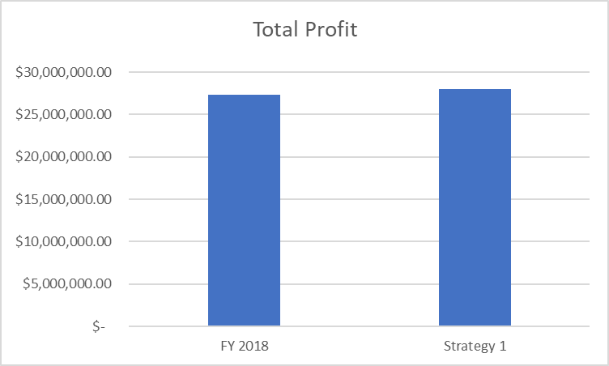
Strategy 1
Notes:
With Strategy 1, we propose that Lariat remove 73 cars from the fleet and that the gap in the fleet would be filled through higher utilization of the remaining cars in the fleet. We project that this would lead to additional profits of approximately $700K.

Slide 5
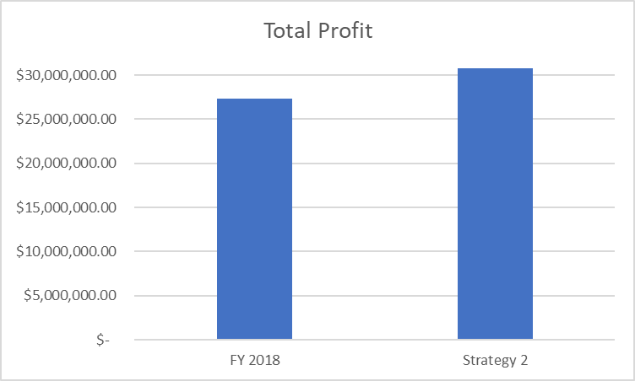
Strategy 2
Notes:
With Strategy 2, we propose that Lariat begin renting cars with a model year of 2016, and that have been in an accident, to renters aged 21 to 24. We assume a young driver’s fee of $30 per day, a 15% increase in the cost of insurance for these cars, and a 25% increase in days rented for these cars. We project that this would lead to additional profits of approximately $3.4 million.

Slide 6
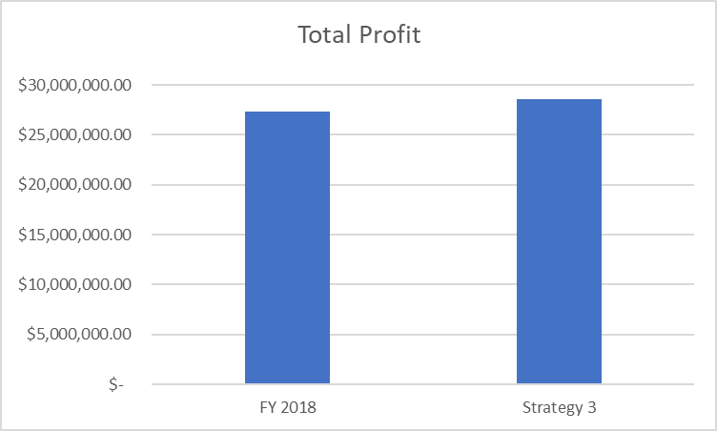
Strategy 3
Notes:
With Strategy 3, we project that Lariat store cars during months where the cars were not rented in FY 2018. We assumed that monthly insurance premiums would not be due during months where the cars were in storage, and that the gap in the fleet would be filled through higher utilization of the remaining cars in the fleet. We project that this would lead to additional profits of approximately $1.2 million.

Slide 7
Recommendation
Implement Strategy 2 and monitor results against forecasting
Consider combining Strategies 1 and 2
Cars to be considered for rental to young drivers are not on the list of unprofitable cars to be eliminated
Notes:
It is our recommendation that Lariat implement Strategy 2, monitor the results of this program against our forecasting, and adjust the program accordingly, including the possibility of renting newer cars to young drivers. It is also our recommendation that Lariat explore the possibility of combining Strategies 1 and 2, as a cursory review of the results indicate that none of the unprofitable cars flagged for removal from the fleet are eligible to be rented to young renters.

